Slide 1
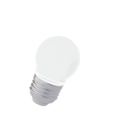
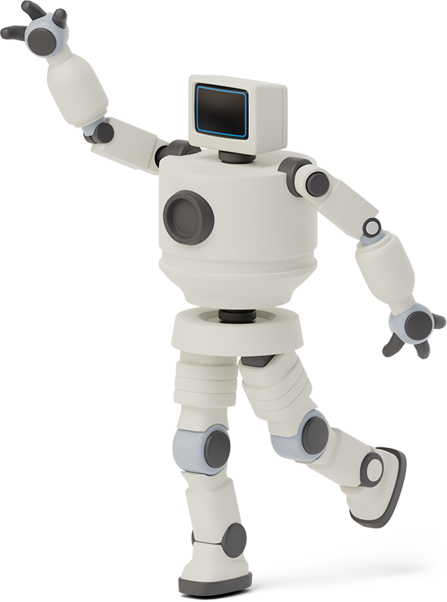


Robo-response

Slide 2
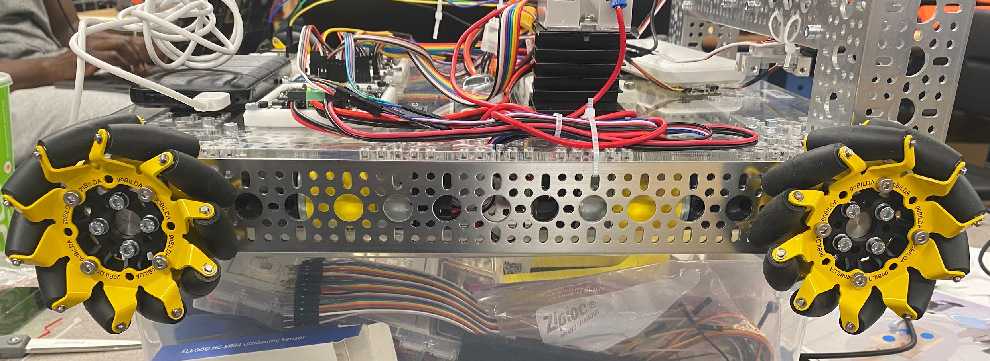
Mobile Robot
Strategy
Autonomous Navigation
Switch to manual control
Controller:
UP - arm raised
DOWN - arm lowered
RIGHT - turn right
LEFT - turn left
JOYSTICK - F, B, L, R
Navigation
Mecanum Wheels
Waypoints to:
AED location
Patient
Controller
Notes:
Pros of Pos. Control: Depth easily adjusted (in real CPR, depth is most important factor)
Cons of Pos. Control:
Calibration is important, if this value is too off, the pumping motion will fail without outside intervention
Rtde move commands are difficult to use – feeding commands at a fast frequency (necessary for faster pumping) results in incomplete movements
Generally found that the robot would drift too high or too low along the z axis despite sending the same range of position commands – position feedback necessary
Pros of Force Control: Far more reliable, no need to calibrate z position, no limitation in frequency of commands
Cons of Force Control: No real way to control position

Slide 3
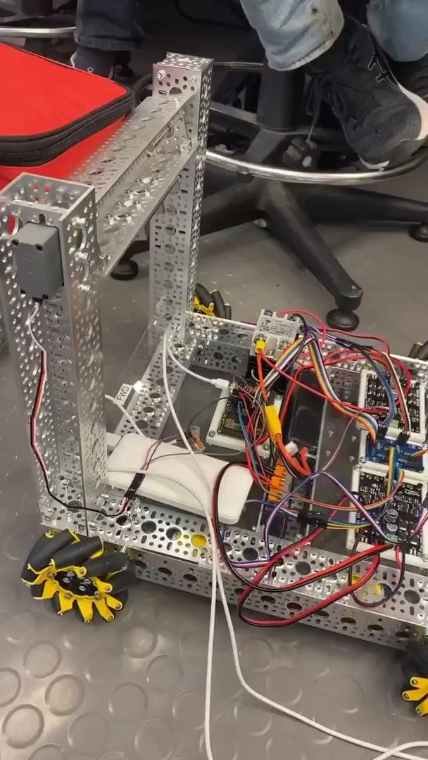
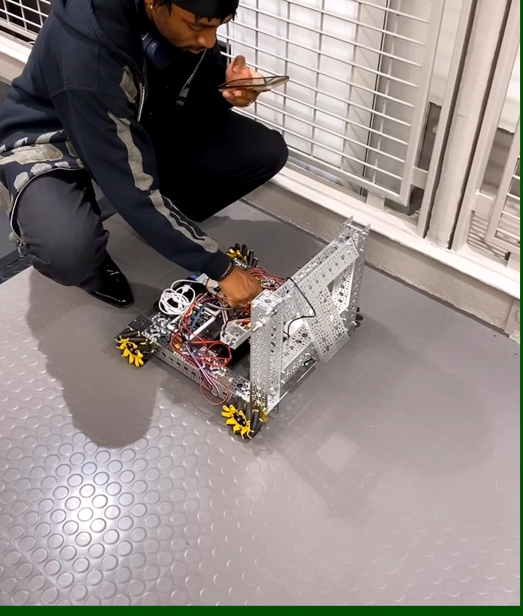
Mobile Robot
Notes:
Pros of Pos. Control: Depth easily adjusted (in real CPR, depth is most important factor)
Cons of Pos. Control:
Calibration is important, if this value is too off, the pumping motion will fail without outside intervention
Rtde move commands are difficult to use – feeding commands at a fast frequency (necessary for faster pumping) results in incomplete movements
Generally found that the robot would drift too high or too low along the z axis despite sending the same range of position commands – position feedback necessary
Pros of Force Control: Far more reliable, no need to calibrate z position, no limitation in frequency of commands
Cons of Force Control: No real way to control position

Slide 4
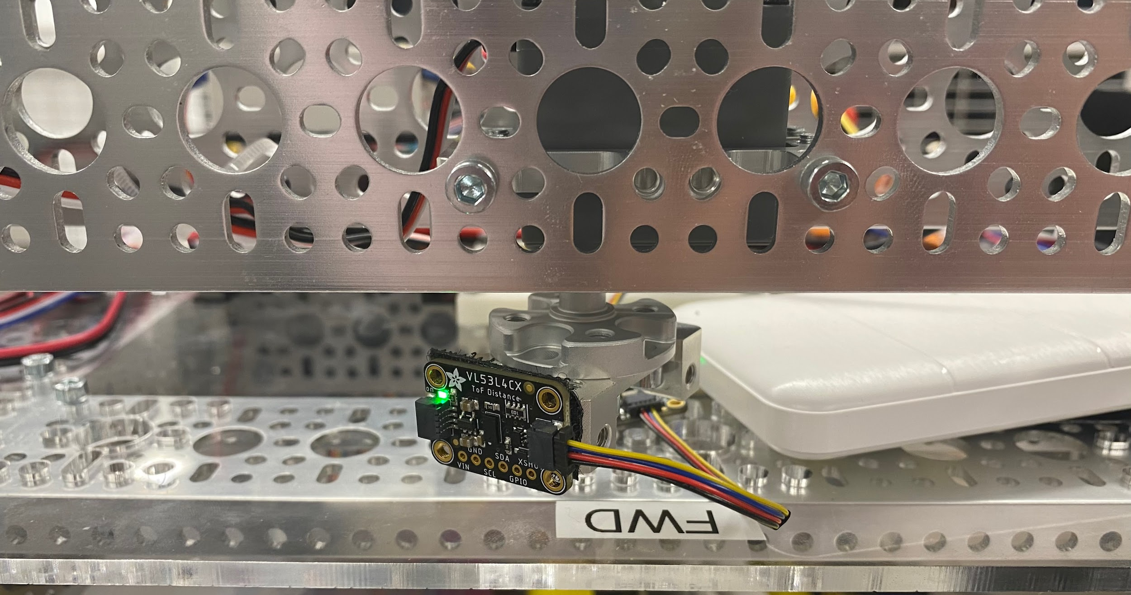
Mobile Robot
Autonomous Obstacle Detection
Time of Flight sensor on servo
90° range of “vision”
If distance drops below threshold →
Move laterally
Resume navigation to target
Lift Mechanism
Arm:
Tilts upward (pick up) or downward (drop off)
Use joystick for arm control
Transport AED at lifted angle
Notes:
Pros of Pos. Control: Depth easily adjusted (in real CPR, depth is most important factor)
Cons of Pos. Control:
Calibration is important, if this value is too off, the pumping motion will fail without outside intervention
Rtde move commands are difficult to use – feeding commands at a fast frequency (necessary for faster pumping) results in incomplete movements
Generally found that the robot would drift too high or too low along the z axis despite sending the same range of position commands – position feedback necessary
Pros of Force Control: Far more reliable, no need to calibrate z position, no limitation in frequency of commands
Cons of Force Control: No real way to control position

Slide 5
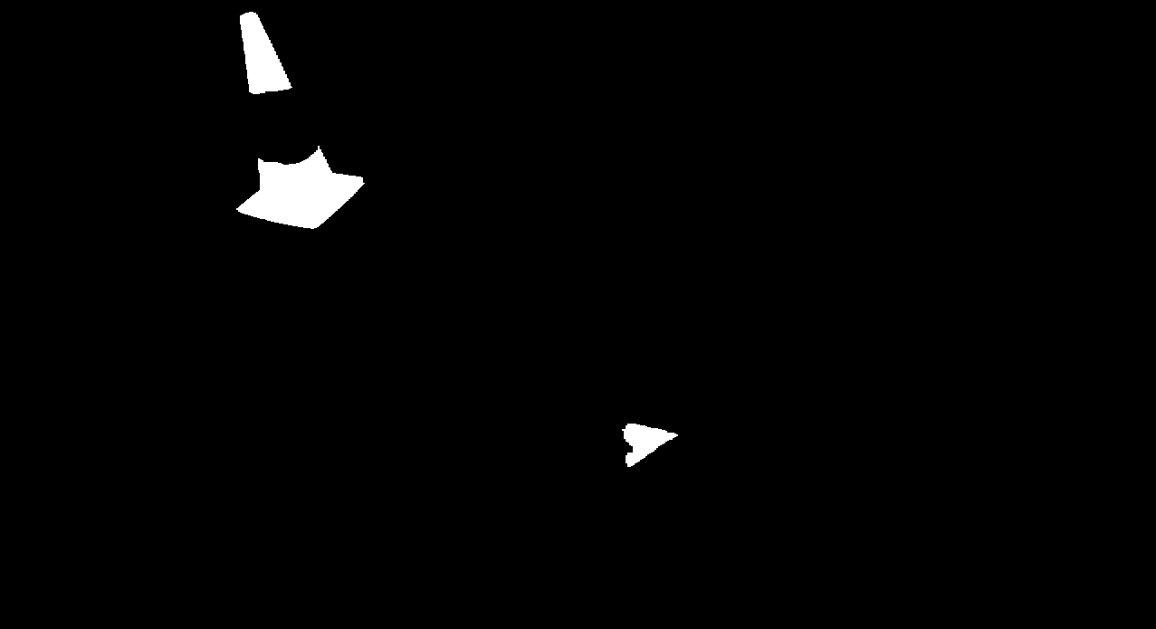
UR5 Vision Continued
Triangle and Red Object Detection
Start the color and depth frame streaming for the intel D435i RealSense Camera
Using a range of HSV values <(0,255),(134,255),(205-255)> detect red objects in the image frame and apply a mask
From the red objects in the image, detect how many contours there are for each object, object with 3 contours is the triangle.
Compute the Center of the Triangle

Slide 6
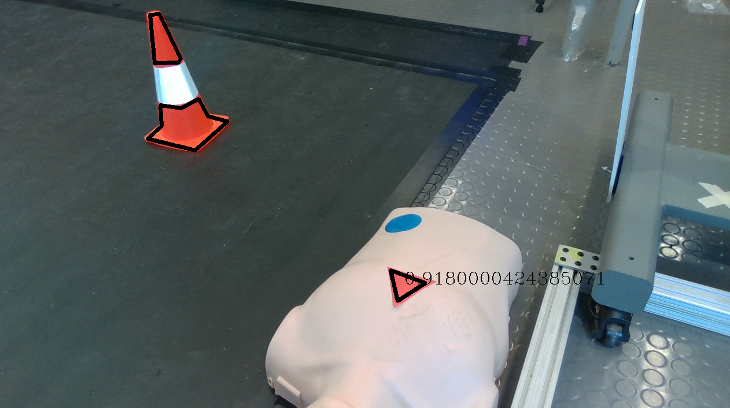
UR5 Vision Continued
Determining Depth and Coordinate Transformation
Using the depth frame and the center of the triangle determine the distance normal to the camera lens( in meters).
Using the camera intrinsics and the depth distance to the object, convert the (x,y) pixel coordinates to the (x,y) 3D coordinates.
Transform coordinates from camera reference frame to ur5 base frame
Send the coordinates of the Triangle to the ur5 manipulator

Slide 7
UR5 cpr
Position Control
Determine z-position of chest
Generate points above and below calibrated z-position
Command arm to move to the points using rtde control commands
Offset drift by checking actual position after each command and shifting pose commands accordingly
Attempts to integrate force control were unsuccessful
Force Control
Determine z-position of chest
Command pumping motion using forcemode – the robot adjusts its position along a given axis in order to achieve the specified force
Force feedback built into forcemode function
Forces generated at a given frequency using a sine wave
Generally a lot easier and more reliable than position control (free of drift, no limits on frequency of commands)
BEST PERFORMANCE: 80% success rate, maximum ~90 bpm (one green light)
BEST PERFORMANCE: 100% success rate, consistently gets two green lights
Notes:
Pros of Pos. Control: Depth easily adjusted (in real CPR, depth is most important factor)
Cons of Pos. Control:
Calibration is important, if this value is too off, the pumping motion will fail without outside intervention
Rtde move commands are difficult to use – feeding commands at a fast frequency (necessary for faster pumping) results in incomplete movements
Generally found that the robot would drift too high or too low along the z axis despite sending the same range of position commands – position feedback necessary
Pros of Force Control: Far more reliable, no need to calibrate z position, no limitation in frequency of commands
Cons of Force Control: No real way to control position

Slide 8
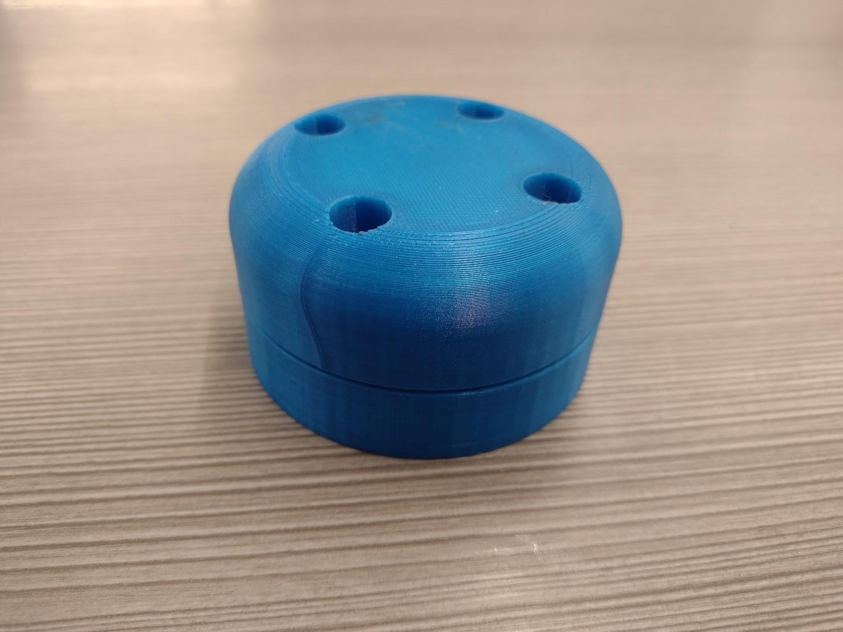
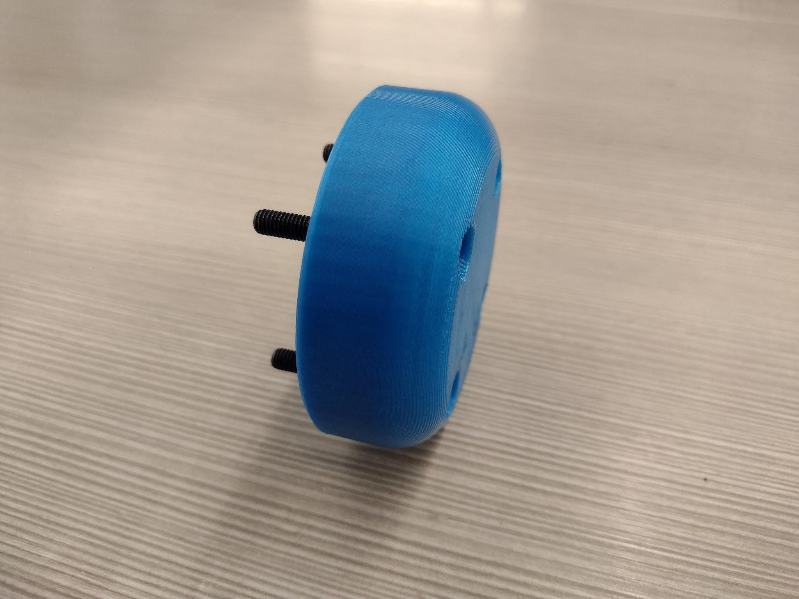
UR5 End Effector
End Effector
Robust, passive design
Bolts directly to the adapter plate
No magnets to damage the force sensors in the UR5
Rounded to prevent stress points on the patient's skin

Slide 9
Avatar
GUI for Remote Robot Control
Streaming real-time robotic arm /force displacement data to Hololens via IP
Visualize state of robotic arm using this data
Enable IP change with buttons and keyboard input
Remote clinician override functionality with intuitive button-based interface
Video Feed for Remote Monitoring
HTTP video stream to Hololens via Raspberry Pi
Read streams on hololens with webcam package
Display video streams on Hololens with mesh render
Enable video source switching in hololens for multiple inputs/robots

Slide 10
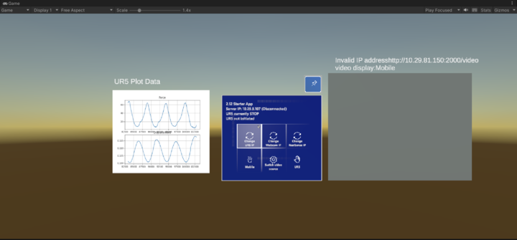
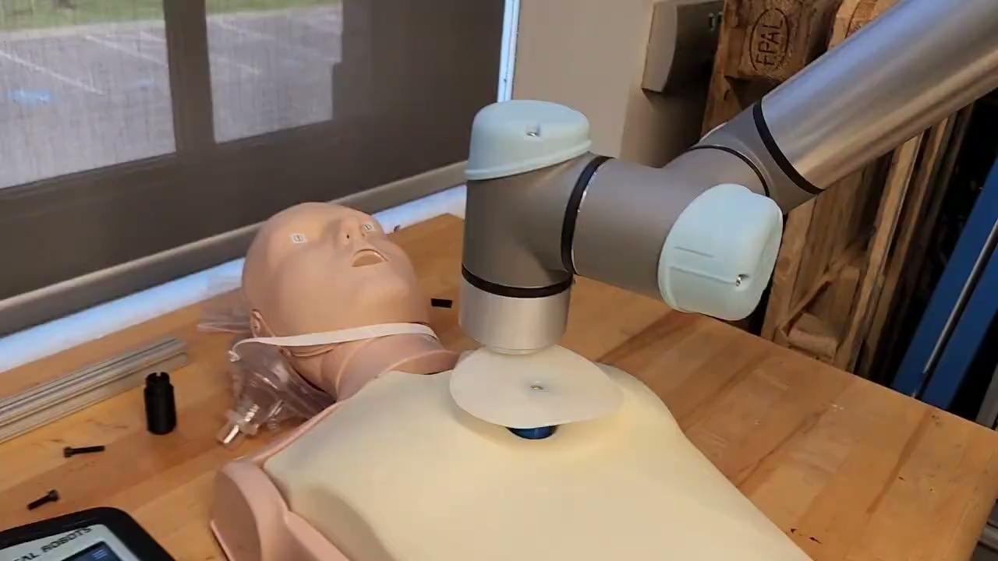
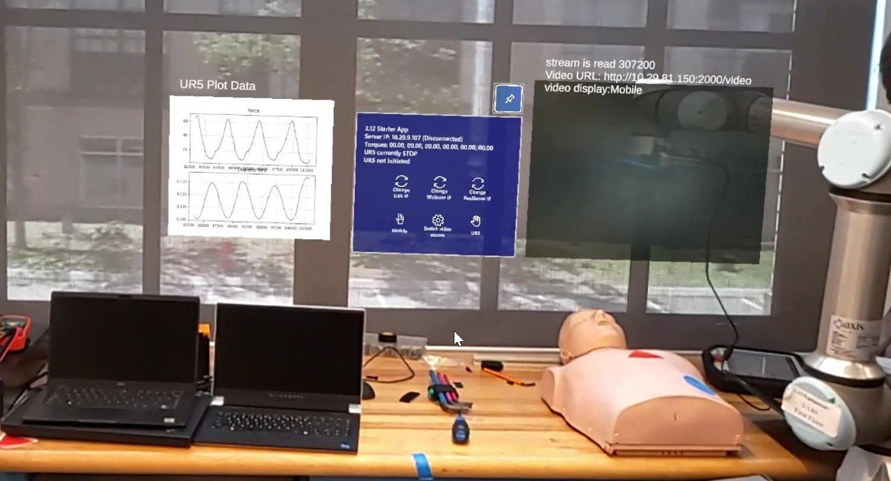
Avatar

